Slide 1
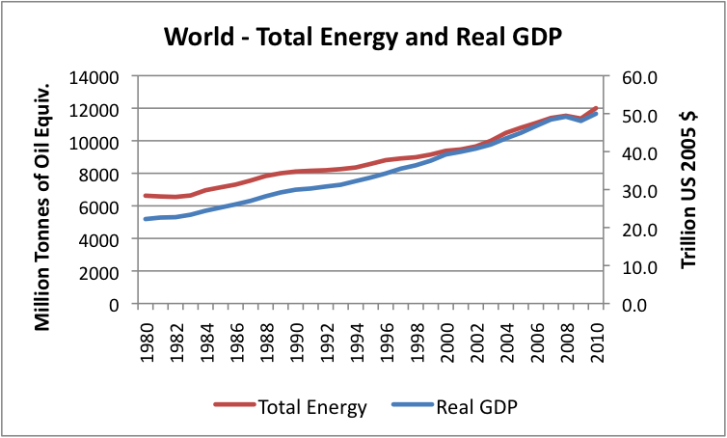

Slide 2
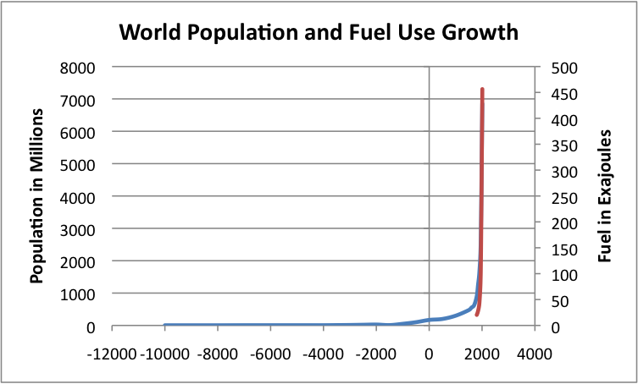

Slide 5
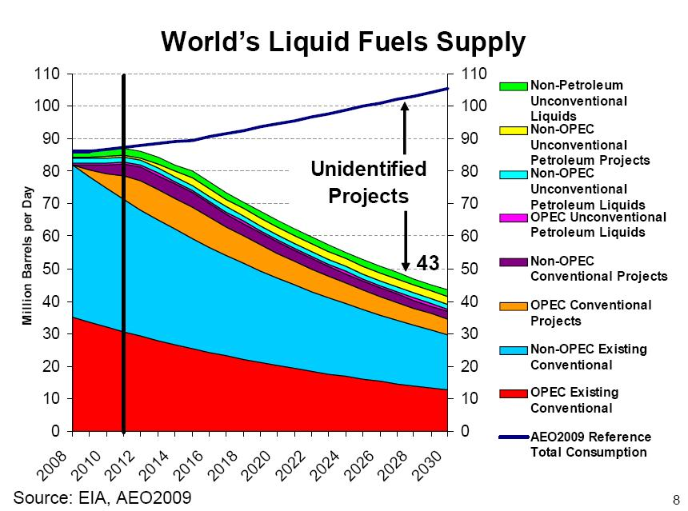

Slide 7
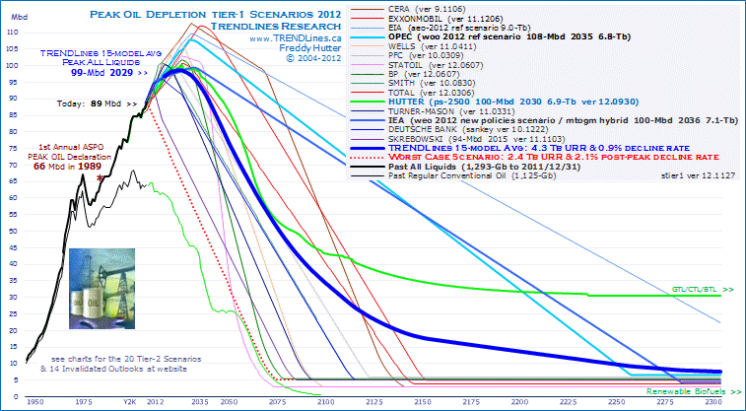

Slide 8
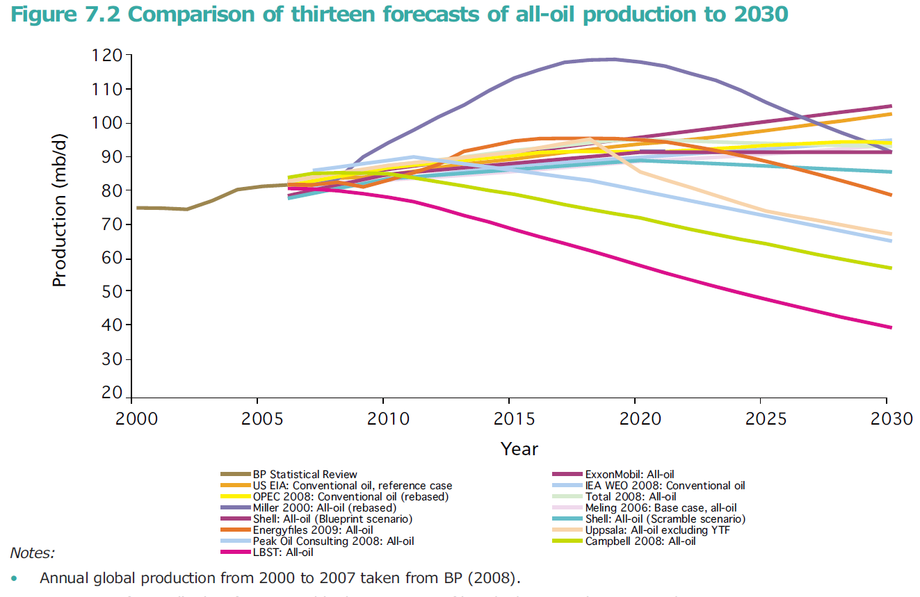

Slide 9
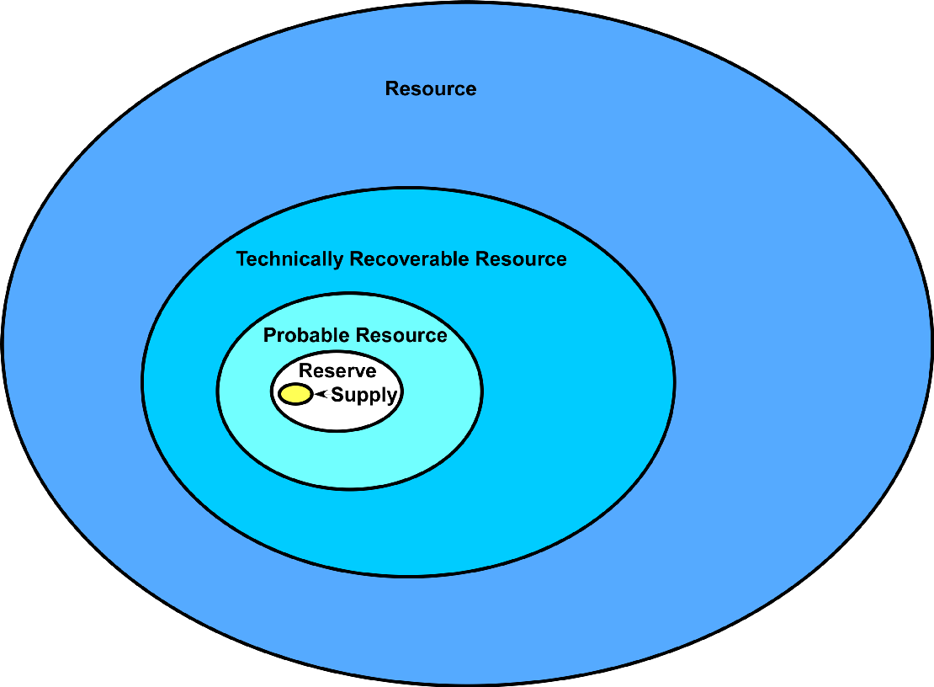
Reserves are a very small sub-set of resources.
Reserves take years of development drilling to become supply.
Proved undeveloped reserves may never be developed.

Slide 10
