Slide 1
Community Wealth Building: A New Paradigm of Community Economic Development Presentation for: MSU CCED Institute Webinar March 26, 2013
Ted Howard
The Democracy Collaborative

Slide 2
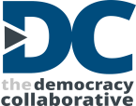
Wealth Inequality in the United States
Sources—Edward N. Wolff, Recent Trends in Household Wealth in the United States, Levy Economics Institute, March 2010; Politifact, “Michael Moore Says 400 Americans Have More Wealth than Half of All Americans Combined,” http://www.politifact.com/wisconsin/statements/2011/mar/10/michael-moore/michael-moore-says-400-americans-have-more-wealth-/

Slide 3
The Prevailing Economic Development Paradigm
Subsidies and tax breaks to entice corporations to relocate
Workforce training not linked to actual jobs
Regional trickle down strategies that don’t reach low- and moderate-income neighborhoods
Low-wage (non-living wage) job creation, often without benefits
Exclusion of ex-offenders and others with barriers to employment
Gentrification and disbursal of traditional residents
“Throwaway cities” and their infrastructure

Slide 4
A New Approach to Economic Development that:
• Promotes broader ownership of capital
• Anchors jobs locally
• Stops the leakage of dollars from communities
• Supports individual and family wealth building
• Reinforces stewardship
• Generates revenues to finance public services
• Leverages anchor institutions for community benefit
• Contributes to local economic stability
What is the Community Wealth Building Paradigm?

Slide 5
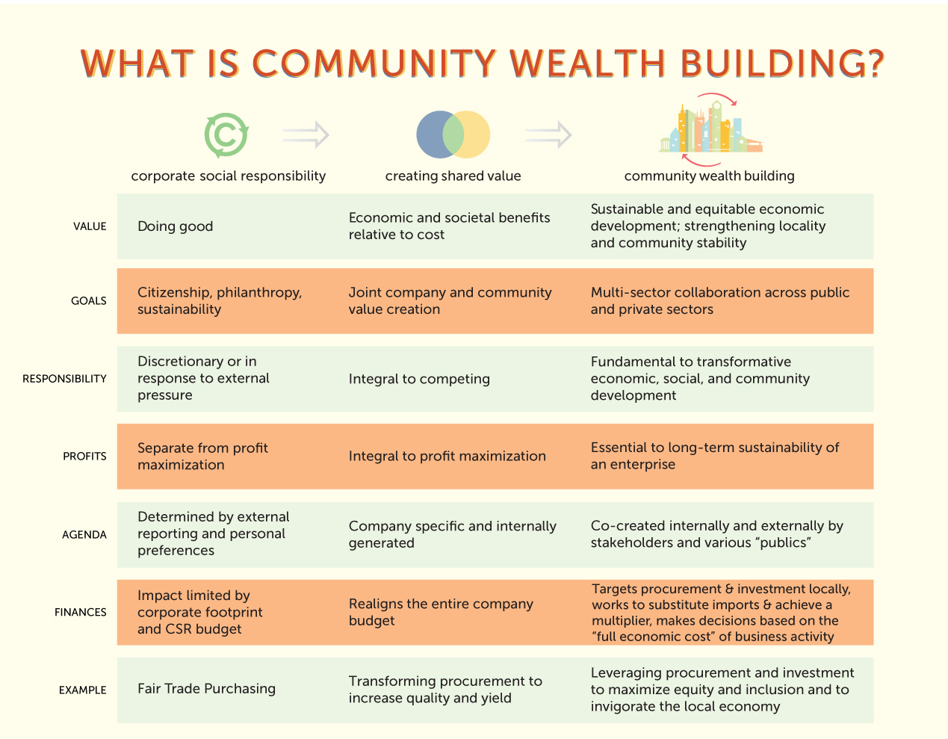

Slide 6
Continuum of Wealth-Building Strategies
BROADENING OWNERSHIP OVER ASSETS AND CAPITAL
Family Wealth Building | Shared Equity | Community/Worker Ownership | Public Ownership or Investment
Individual Development Accounts Microenterprise Family Self-Sufficiency Program “Baby Bonds” & child savings accounts Earned Income Tax Credit volunteer assistance programs Alternatives to predatory lending Nonprofit financial education programs | Community Land Trusts Limited Equity Cooperatives Deed restriction (inclusionary zoning) Mixed ownership (Market Creek) Program-Related Investments CDC/CDFI equity investments or joint ventures Community benefits agreements | Anchor institutions (eds, meds, churches, museums, libraries) ESOPs or worker cooperatives Credit unions Community corporations CDC or CDFI direct ownership Social enterprises Commons-based enterprises (e.g., Wikipedia, Creative Commons licenses) | Municipal enterprise State & local venture investments Public pension fund ETIs (economically targeted investments) Public leases: land & transit development Stock warrants in exchange for granting tax breaks (fair exchange) Trustee ownership (e.g., Alaska Permanent Fund)
www.Community-Wealth.org
© The Democracy Collaborative
Notes:
6

Slide 7
An Integrated Community Wealth Approach
Key Components
Putting the Pieces Together
Family
Wealth
Building
Community
Ownership
Help individuals build wealth and savings (using matched-savings programs, etc.)
Create community owned businesses and other entities that provide living wage jobs and anchor wealth in low-income communities
Link community businesses with anchor procurement needs
Anchor
Institutions

Slide 8
Strategy #1: Community-Based Business Ownership New Communities CDC (Newark, NJ)
Strategy #1: Community-Based Business Ownership
New Communities CDC (Newark, NJ)
Founded in 1968 by Monsignor William Linder, then a young parish priest
Employs 1,300 neighborhood residents
Manages 2,000 units of affordable housing
Developed a shopping center that houses community- owned businesses and services
Assets exceed $500M
Proceeds help support day-care and after-school programs, health services, and a Youth Automotive Training Center that trains auto technicians
Founded in 1968 by Monsignor William Linder, then a young parish priest
Employs 1,300 neighborhood residents
Manages 2,000 units of affordable housing
Developed a shopping center that houses community- owned businesses and services
Assets exceed $500M
Proceeds help support day-care and after-school programs, health services, and a Youth Automotive Training Center that trains auto technicians

Slide 9
Strategy #2: Community Ownership Market Creek Plaza (San Diego, CA)
Mixed-use development: Community-designed $65M commercial and cultural complex, anchored by a shopping center, in SE San Diego Diamond neighborhood.
Mixed individual & community ownership
Community shares: 423 residents own shares, raising $500,000 (20 percent equity — will own 50 percent after parent foundation (Jacobs Foundation) exits in 2018.)
Local community foundation ownership: Neighborhood foundation has 20 percent equity—will own 50 percent after parent foundation exits.
Green: Complex is on brownfield site and adjacent to San Diego trolley line -- example of transit-oriented development

Slide 10
Strategy #3: Social Enterprise Roberts Enterprise Development Fund (REDF)
Defining Social Enterprise – “organization or venture that achieves its primary social or environmental mission using business methods.”
REDF Venture Philanthropy – Grant funding and business expertise
Creating Jobs - Connect marginalized populations with job opportunities in social enterprises, helped 5,700 people to date
Increasing Revenue for Non-profits – over $100M to date
Partnering with companies – to purchase the good/service from a portfolio social enterprise and/or hire social enterprise graduates
Part of a growing social enterprise sector with combined assets of more than $500M
Defining Social Enterprise – “organization or venture that achieves its primary social or environmental mission using business methods.”
REDF Venture Philanthropy – Grant funding and business expertise
Creating Jobs - Connect marginalized populations with job opportunities in social enterprises, helped 5,700 people to date
Increasing Revenue for Non-profits – over $100M to date
Partnering with companies – to purchase the good/service from a portfolio social enterprise and/or hire social enterprise graduates
Part of a growing social enterprise sector with combined assets of more than $500M

Slide 11
Strategy #4: Community Land Trust Dudley Street Inc.
Strategy #4: Community Land Trust Dudley Street Inc.
Non-profit. Typical board: 1/3 residents, 1/3 non-resident members, and 1/3 public officials.
Created as a way for the community residents to address vacant, abandoned properties in this neighborhood in Boston
The organization owns the land with resident homeownership
Not just housing — can be used commercially.
All parties agree to ensure the long-term affordability of the properties, while the CLT owns the land in order to enforce that agreement
Shared equity maintains “permanent affordability.”
Very low foreclosure rates: in 2009, CLT homes had a foreclosure rate of 0.56 percent versus national “prime” loan average of 3.31 percent and subprime average of 15.58 percent.
Non-profit. Typical board: 1/3 residents, 1/3 non-resident members, and 1/3 public officials.
Created as a way for the community residents to address vacant, abandoned properties in this neighborhood in Boston
The organization owns the land with resident homeownership
Not just housing — can be used commercially.
All parties agree to ensure the long-term affordability of the properties, while the CLT owns the land in order to enforce that agreement
Shared equity maintains “permanent affordability.”
Very low foreclosure rates: in 2009, CLT homes had a foreclosure rate of 0.56 percent versus national “prime” loan average of 3.31 percent and subprime average of 15.58 percent.

Slide 12
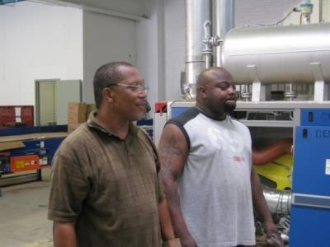
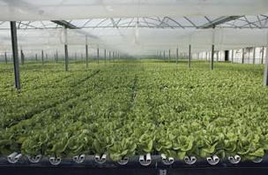
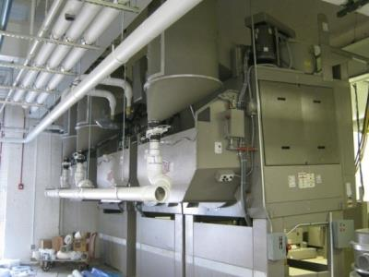
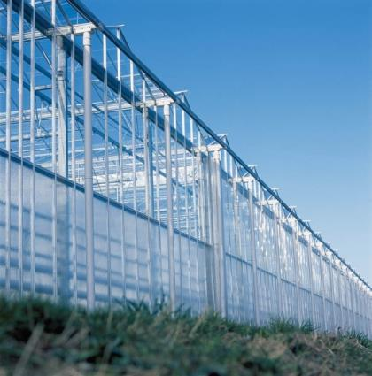
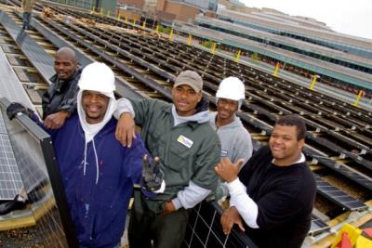
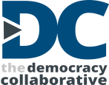

Slide 13
MONDRAGÓN
100+ networked cooperatives
Notes:
One of the best-known examples is the 85,000-person Mondragón cooperative network in the Basque region of Spain, which has 32.5 billion in assets across a network of companies that include retail (a major grocery chain), manufacturing, financial services and education.
Here we see the Danobat group, which includes aerospace and automotive production and wind power.

Slide 14
The Emerging Community Wealth Economy
Institutional Form | Number of Organizations | Estimated Assets
CDCs | 4,600 | At least $2 billion
Nonprofit Social Enterprise | 480 | More than $500 million
CDFIs | 1,200 | $25.8 billion
ESOPs | 11,400 with 13.4 million members | $922.5 billion
Cooperatives and Credit Unions | 29,285 | $3.126 trillion
Community Land Trusts (CLTs) | About 200 | Approximately $500 million
Municipal Enterprise | 25,000 (including 2,000 utilities) | At least $80 billion (public power alone)
Public pensions (economically targeted investments) | Used in some form by about half of all state pension funds | About $60 billion (2% of total state and local public pension dollars)
Universities | About 4,000 | Endowment assets alone are $411 billion
Nonprofit hospitals | About 3,000 | $600 billion
Foundations | About 66,000 | $650 billion
IDAs | About 500 (86,000 savers) | $550 million
Micro-enterprise | About 500 | $1.5 billion
Approximate Total | Over 140,000 | More than $5 trillion in assets

Slide 15
For more information:
www.Community-Wealth.org
thoward1@umd.edu

