Slide 1
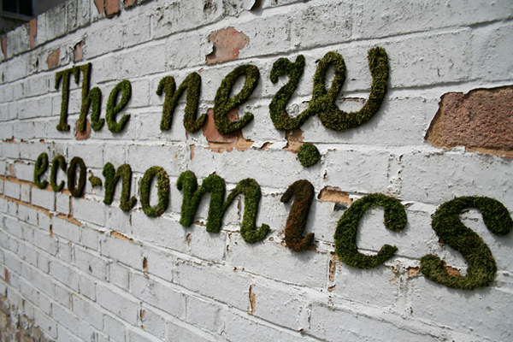
Juliet Schor
MSU
March 2013

Slide 2


Slide 3
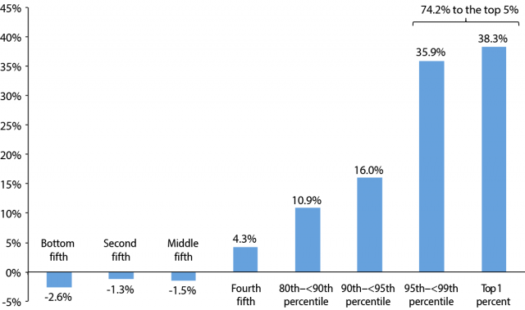
Extreme concentration of wealth
Source: Ed Wolff, using Survey of Consumer Finances, Federal Research Board, 2010

Slide 4
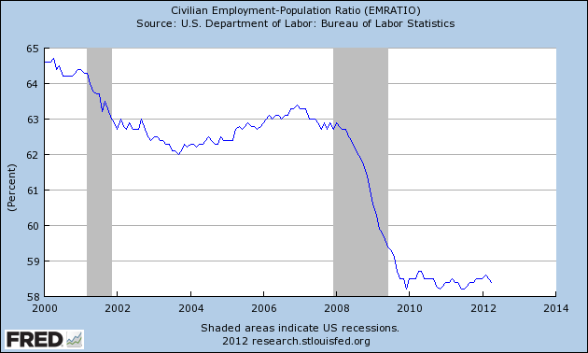
Recovery fails to bring employment gains
Notes:
Recession ended june 2009, but job growth only about sufficient to absorb new entrants.
25.1 million under or unemployed
Shrinking labor force, need 11.4 million jobs to get back to prerecession levels. Lost 8.7 m jobs, created 1 m private sector jobs in the recovery, still down 7.7 M jobs. Add 3.7 m in new entrants to get the 11.4

Slide 5
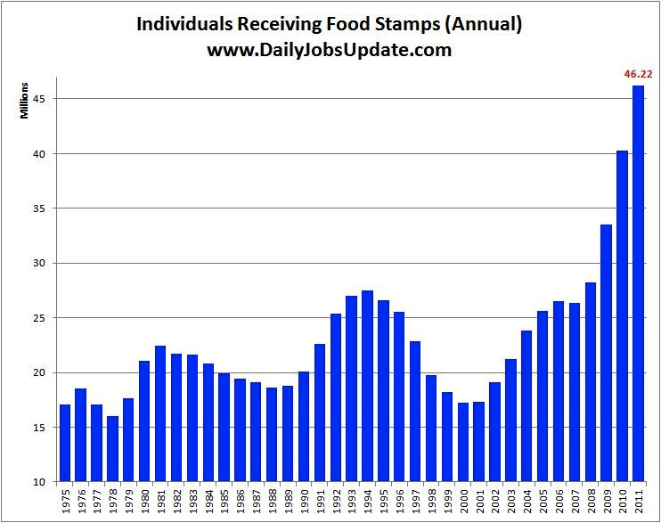
Rising poverty: food stamp use soars to 46 million

Slide 6
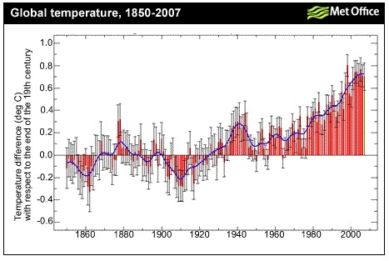
Ecological outcomes: a warming planet

Slide 7
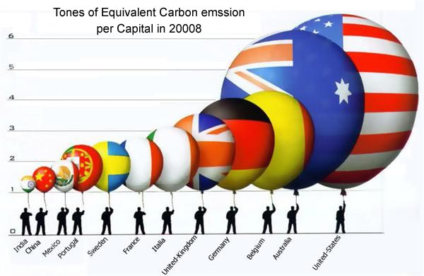

Slide 9

Ecologically committed
Maintain economic activity within the limits of the biosphere
Committed to urgent action on climate
Committed to ecological restoration, resilience, full cost pricing
Triple Dividend approaches: Initiatives which support the goals of democracy and equity tend to reduce carbon use, eco-footprints and promote eco-restoration.

Slide 10
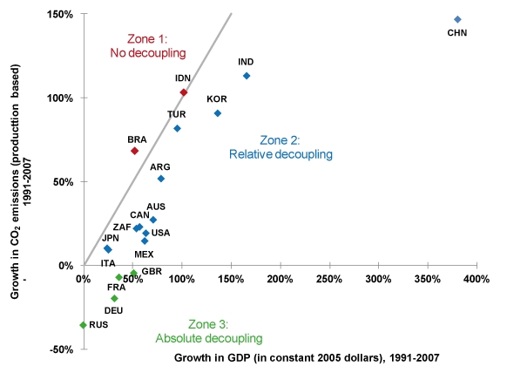
Growth versus climate

Slide 11
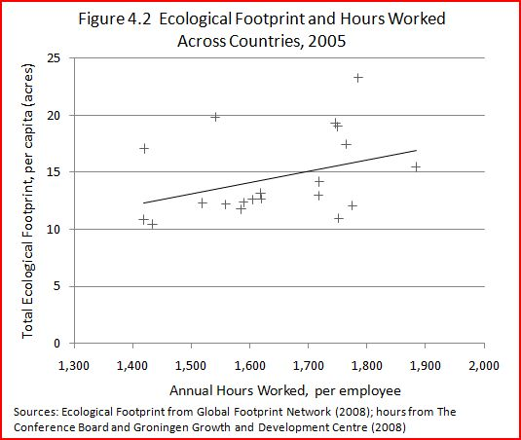
Shorter hours are essential to emission reduction and a sustainable footprint

Slide 12
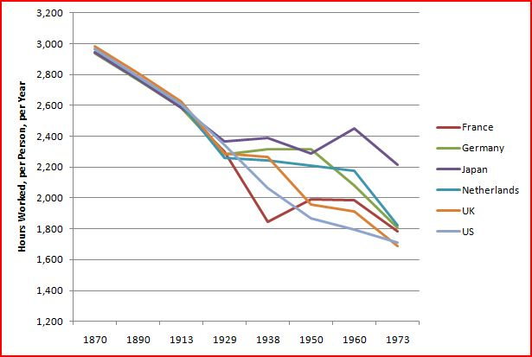
The long history of hours reductions

Slide 13
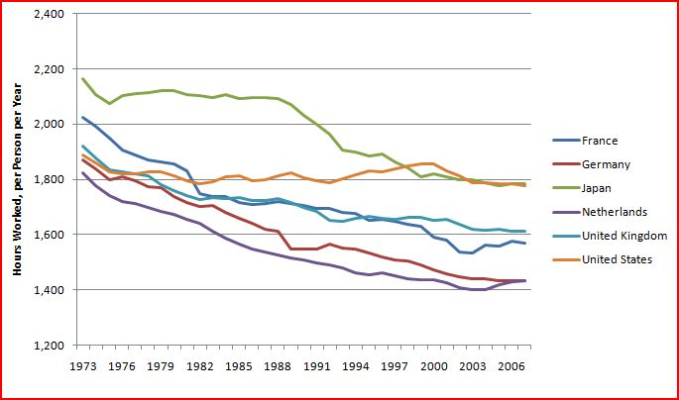
Working Hours in Selected Countries, 1973-2007

Slide 14

Committed to consumption sharing and peer production
Peer to peer
Old and new forms of sharing
Internet enabled trust and reputation
Surplus goods facilitate markets of re-use and re-sale

Slide 15
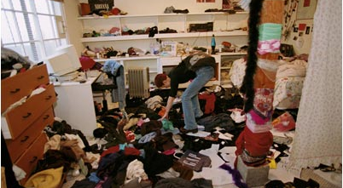
The fast-fashion era

Slide 16
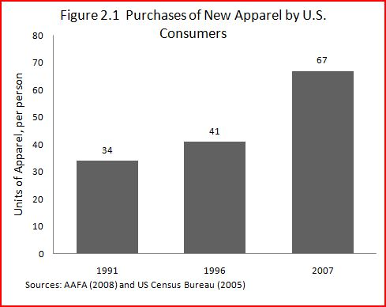
unsustainable apparel consumption

Slide 17


Slide 18


Slide 19

The sharing economy

Slide 20
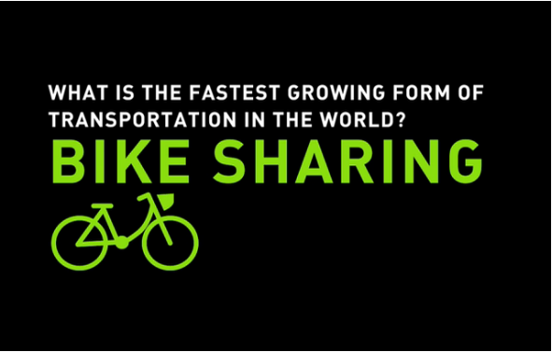

Slide 21
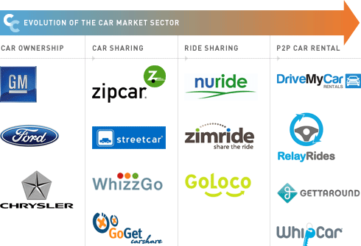
Transportation transformed

Slide 22


Slide 23


Slide 24


Slide 25

Technologically Forward
New technologies enable new economic models and social relations of production (peer production, collaborative consumption)
Role of open source/open access in fostering innovation
Importance of eco-knowledge
New possibilities for productivity growth and advancement of well-being

Slide 26
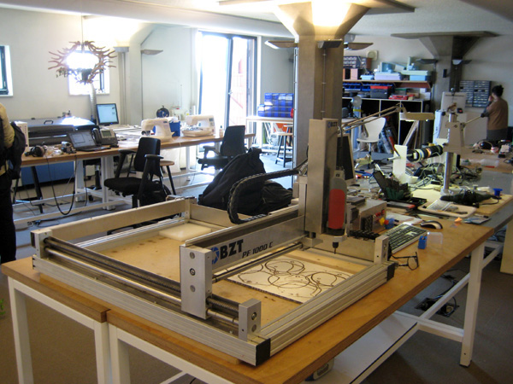
FAB LABS: small-scale, high-tech, manufacturing marvels

Slide 27
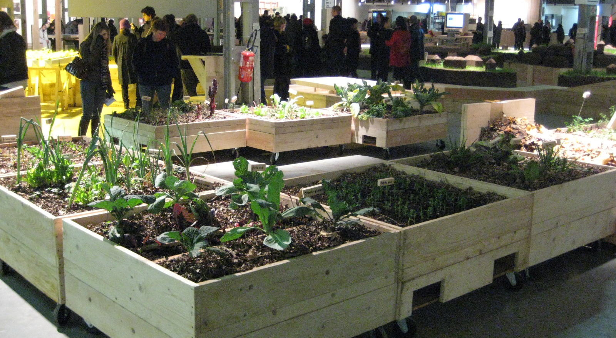
The growing importance of eco-knowledge: permaculture

Slide 28

Reduction in scale
Scale relevant for a variety of aims including democracy and equity
De-centralized and networked
Strengthening local (by which mostly is meant regional) economies
Critical of certain kinds of globalization. Not radically localist. Subsidiarity principle.

Slide 29

Democratization of Wealth
Widespread access and ownership of productive assets by class, race, ethnicity and gender
Cooperatives, Land Trusts, CDCs, B-corps, municipally owned enterprises, mixed profit/non-profits
Importance of social capital, cooperation
The Cleveland Model: the Evergreen Cooperatives

Slide 30
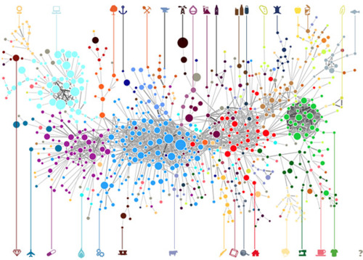
Complex, bottom up and participatory
The economy as a complex system
Decentralized networks
Power widely dispersed and vested in democratic processes and practices

Slide 31
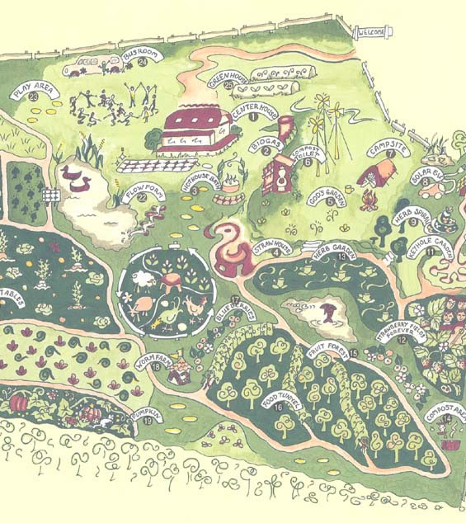
Pluralist, hybrid
Monoculture is unsustainable, in eco-systems, economies and in knowledge ecologies (eg, mainstream economics)
Diversity = resilience
New economics embraces a multitude of forms of enterprise and practice

Slide 32
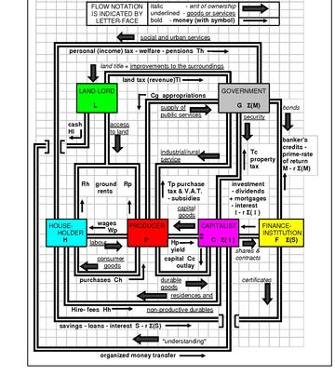
Whole system change
A failing economic model requires systemic change
System change requires transformation on multiple fronts: economy, society, culture, governance, ecology
Alternatives already emerging in virtually every area

